Slide 1
Emotics
by Small Data

Slide 2
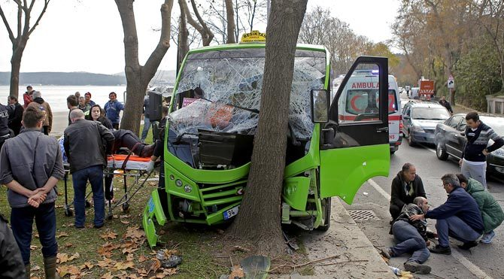
ARE WE SAFE ?
AM I SAFE ?

Slide 3
EMOTICS

Slide 4
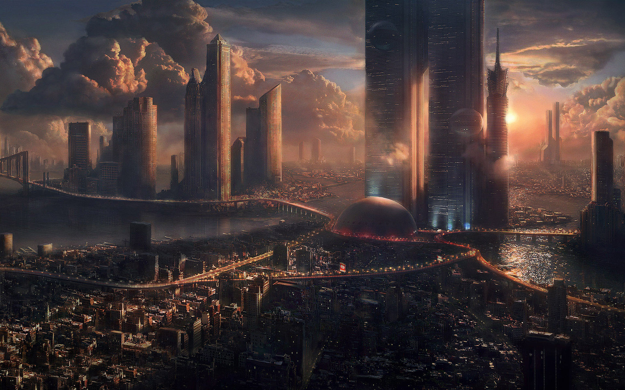
~30 now… ~40 in 2030

Slide 5
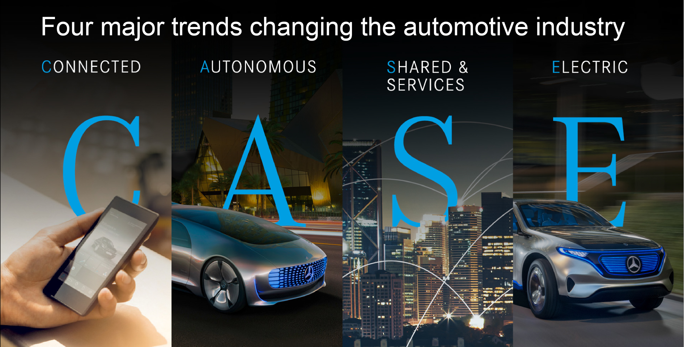

Slide 6
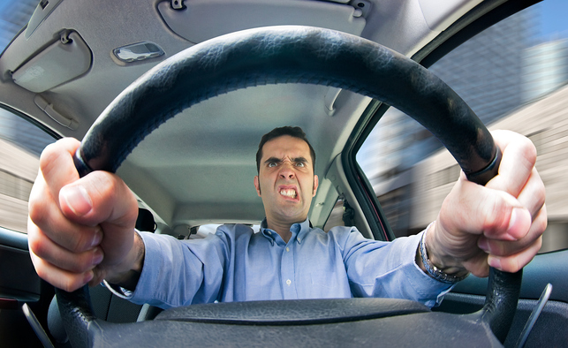

Slide 7
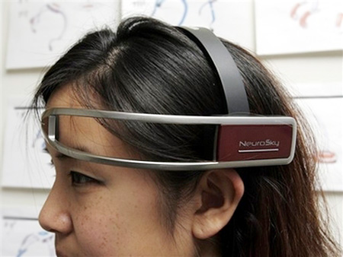
1
Brain Waves

Slide 8
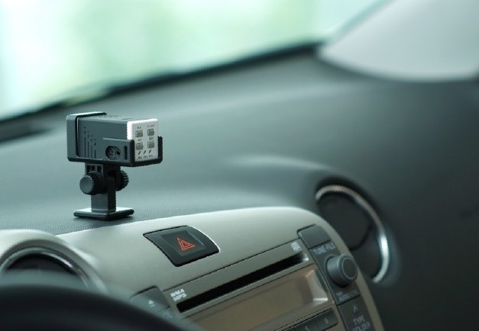
2
Camera

Slide 9
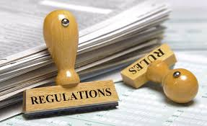
Regulations
time consuming
human bias

Slide 10
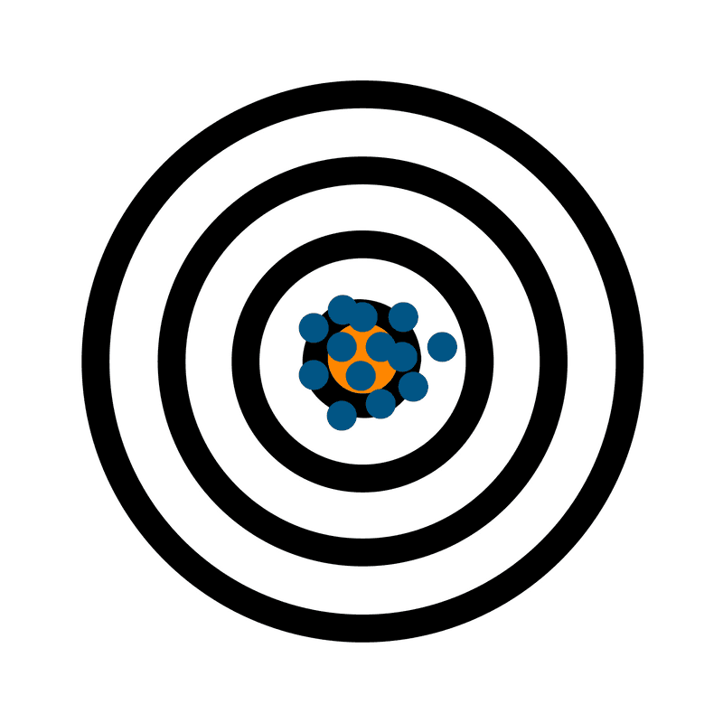

Slide 11
TRUST IN THE VEHICLE
WILL BRING
TRUST IN THE MANUFACTURER

